Slide 1
6. Software management

Slide 2
Content
Before installation
Software distribution model
Software Source
Using packaged source
Software dependency
High level software management tools

Slide 3
Before installation
Type of software
Open source software
Free software
Public domain sotfware
Copylefted software
GPL software
Freeware
Shareware
Proprietary software
Be sure that you understood the license
Notes:
Classification and definition of software (According to the definitions of Free Software Foundation):
• Free software (open source software): Free software is software that comes with permission for anyone to use, copy, and distribute, either verbatim or with modifications, either gratis or for a fee. In particular, this means that source code must be available. The copyright belongs to the producer.
• Public domain software:The public domain software is a legal term meaning that the copyright is abandoned. The software classified into this category are not copyrighted.
• Copylefted software:The copyleft is software that put the obligation to provide the freedom of the use of the source code, the correction, and the re-distribution when distributing it again.
• Non-copylefted free software:Non-copylefted free software comes from the author with permission to redistribute and modify, and also to add additional restrictions to it.(representative example: X)
• GPL-covered software: Software protected by GPL (GNU General Public License). GNU software is protected with GPL.
• Semi-free software:Semi-free software is software that is not free, but comes with permission for individuals to use, copy, distribute, and modify (including distribution of modified versions) for non-profit purposes.
• Proprietary software:Its use, redistribution or modification is prohibited, requires permission
• Freeware:Software that limits the modification and the obtaining of the source code, though its re-distribution is generally permitted.
• Shareware: Shareware is software which comes with permission for people to redistribute copies, but says that anyone who continues to use a copy is required to pay a license fee. For most shareware, source code is not available; thus, you cannot modify the program at all.

Slide 4
Before installation
Sources that we can get softwares
Binary
Source code
Can get from Internet (http, ftp)
Can get from local store (cd, dvd, hdd)
Notes:
After understanding the license, in the technique view, we’ll learn about how to install the software. There are several option to install a software:
User can get the binary code of the program, and then install it on the machine manually or via setup scrip. Software can also be installed via getting and compiling source code, than installing the obtain binary code. Most of the compiling scripts includes installing script.
The source (binary or code) is available from internet, can be stored in local hard disk, or distributed via removable media such as cd, dvd, …

Slide 5
Software distribution models
Software dependency
Source code distribution model
Binary code distribution model
Notes:
Unfortunately, it is not so simple to get the source and install software. Programs are not independent each other. Most of programs need several shared library. Common libraries are shared between many programs. When install a program, if the libraries are not installed, they have to be installed. So we need to install other software when needed. And if these software depends on other software, we need to install the latest!
This dependency sometime leads to the problem of conflicting. SW1 needs version 1.0 of SW2, whereas SW3 needs version 2.0. If 2.0 is compatible to 1.0 then we have to install 2.0. But if SW1 is old then it can not support 2.0, then we can not use SW1 and SW3 at the same time. And we have thousands software!
To detect and resolve the dependency and conflict, each system has a software management system. In Linux distributions, there are two basics software management mechanism provided by Redhat and Debian: rpm and dpkg.
These mechanism provide control not over dependency and conflicts, but also configuration files and packaging software. Via rpm and dpkg, user can install software from binary code packaged with installation script in a package. Thousands packages are available via internet. They are stored in repositories.

Slide 6
Source Distribution Model
Producer distribute software by source code (C, Python, Java)
User has to
Clean the old version (clean script)
Preparation for compilation (configure script)
Compile the code (compile script)
Move it to right place (install script)
Preparation for execution environment (post install script)
Those script can be integrated in one Makefile
Managed by automake application
Need development packages
Security problems
Notes:
In this distribution model, software is distributed by set of source code. When compiling this code, a set of binary file is obtained. Then these file have to be installed to correct location on the file system.
Normally, a source package includes source code, configure script, clean script, install script and post install script.
The configure script checks whether the environment of the system is compatible to the software. It verifies if the shared library a available, if there is any conflict with existing software in the system. It configure also the parameters of the compilation and writes it to makefile.
The compiling script compiles the sourcecode to binary files and place them in the source code directory.
The install script copies files into predefined system directories.
After installation, default parameters have to be activated and certain preparing operations have to be executed. This is done by post install script.
When uninstall a software, binary and configuration files have to be cleaned. This actions are executed by a cleaning script.
In a standard source code distribution, all of these scripts are integrated in one make file script. The scripts are selected by corresponding option.

Slide 7
Examle of x-unikey installation
Getting source
Compiling
Installing
Notes:
Visit the webpage of x-unikey
Download the source code of the software
Un tar the source code
Execute the configure script
Compiling
Installing (this two script can be executed as once)
Checking if x-unikey is installed
Unistalling x-unikey

Slide 8
Using packaged installation source
Binary code are packaged in one file
Dependency information are included in the file
Need a tool to verify the dependency
The tool has its own DB for dependency
2 popular tools / DB architectures
dpkg
Rpm
Notes:
Action
Install
Uninstall
Configure
Reconfigure
Query the software status
Check whether installed
Check dependency
Query the package status
Package information
Package content
Package content
Name
Version
Release number
Platform
extension

Slide 9
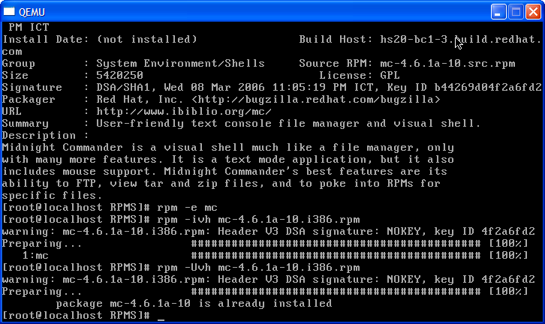
Rpm example - 01

Slide 10
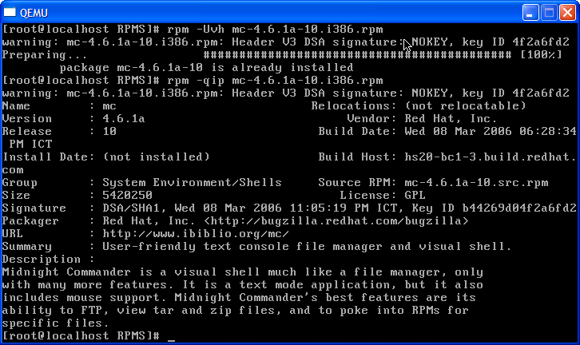
Rpm example - 02

Slide 11
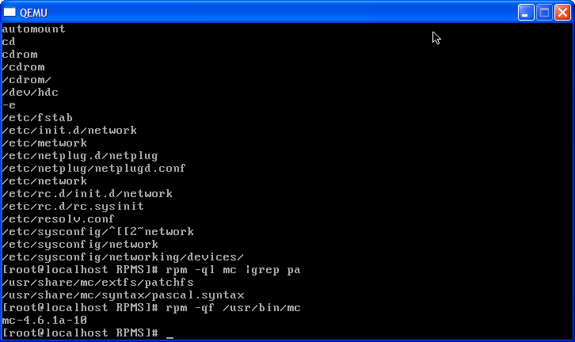
Rpm example - 03

Slide 12
Softwares dependency
Examle of installation of X-windows
Large number of preinstalled software
Circlic dependency
Uninstalling can affect other applications
Difficult to install/uninstall
Needs help

Slide 13
High level software management tools
Offered by distributor
Client/server model
Interactive interface (text/graphics)
Automatic dependency management
Automatic repository management
Searching capability
Manage thousands applications
yum, urpm, apt, aptitude

Slide 14
Yum
Support for multiple repositories
Simple configuration
Dependency calculation
Fast operation
RPM-consistent behavior
Package group support, including multiple-repository groups
Simple interface
Notes:
All of the tools that we have learned works over one software as once. This is not comfortable when working with a complex software system with thousands software. Linux distributions provide tools that manage all of the software installed on a machine at once.
This tool includes a database for software dependences. It will connect with a remote or local directory to get this database. The source of the packages is also downloaded from repository.
In Redhat, the tool is YUM

Slide 15
Summary
Software management
Version, configuration, dependency, package, conflict
Low level tools: rpm, dpkg, source code compiling
High level tools yum, apt, ….
Interactive tools: aptitude, yumex, …

